Slide 1
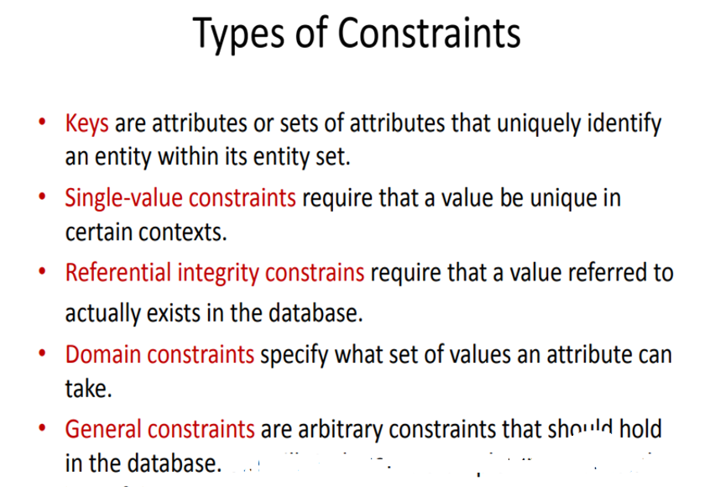
The Modeling of Constraints
Classification of Constraints

Slide 2
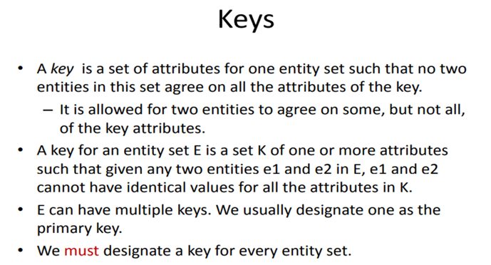
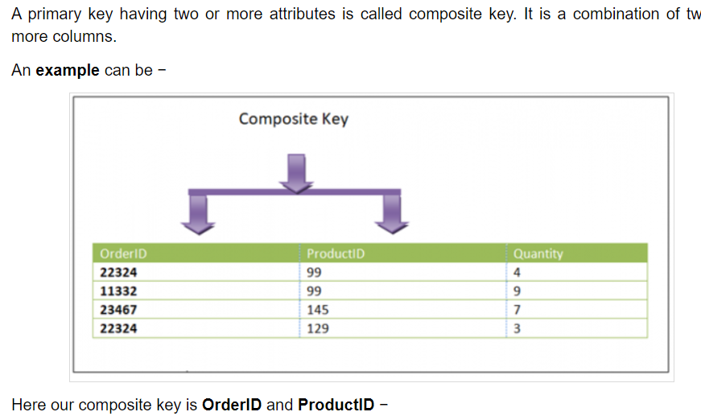
The Modeling of Constraints

Slide 3
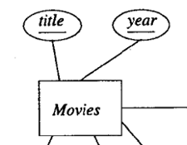
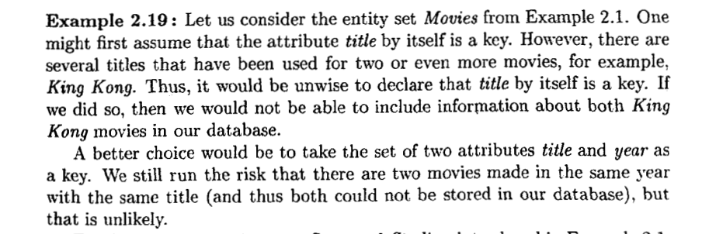
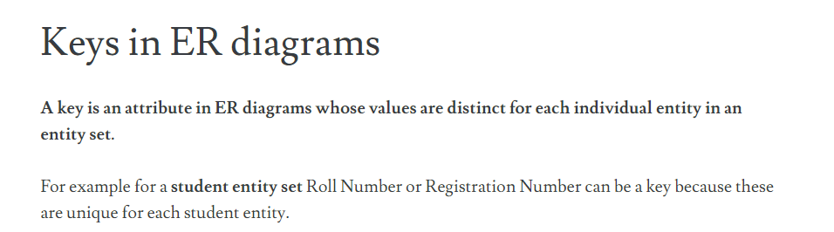
The Modeling of Constraints
Keys in ER Model

Slide 4
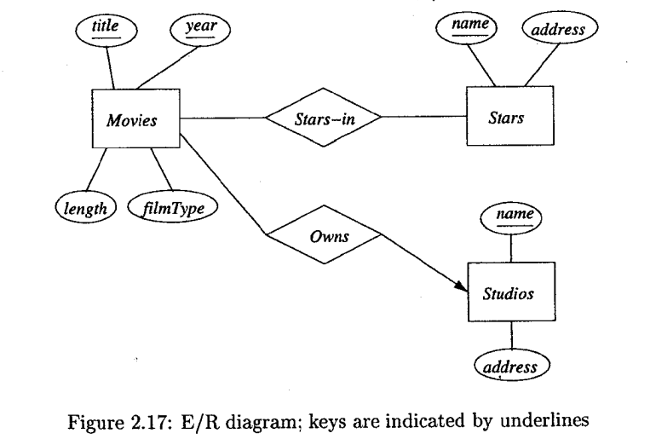
The Modeling of Constraints
Representing Keys in the E/R Model

Slide 5
The Modeling of Constraints
Single value constraint
There are several ways in which single-value constraints are expressed in the E/R model.
Each attribute of an entity set has a single value. Sometimes it is permissible for an attribute's value to be missing for some entities, in which case we have to invent a "null value" to serve as the value of that attribute.
A requirement that a certain attribute not have a null value does not have any special representation in the E/R model.
A relationship R that is many-one from entity set E to entity set F implies a single-value constraint. That is, for each entity e in E, there is at most one associated entity f in F.

Slide 6
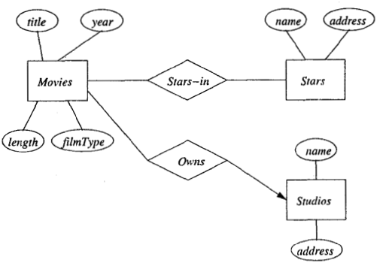
The Modeling of Constraints
Referential Integrity
While single-value constraints assert that at most one value exists in a given role, a referential integrity constraint asserts that exactly one value exists in that role.
"referential integrity" is more commonly used to refer to relationships among entity sets.
Consider the many-one relationship Owns from Movies to Studios in the many-one requirement simply says that no movie can be owned by more than one studio. It does not say that a movie must surely be owned by a studio, or that, even if it is owned by some studio, that the studio must be present in the Studios entity set, as stored in our database.
A referential integrity constraint on relationship Owns would require that for each movie, the owning studio (the entity "referenced" by the relationship for this movie) must exist in our database.

Slide 7
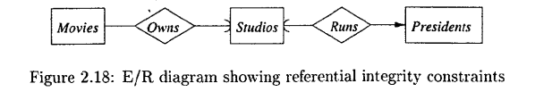
The Modeling of Constraints
Referential Integrity in E/R Diagrams
Figure below shows some appropriate referential integrity constraints among the entity sets Movies, Studios, and Presidents
A rounded arrow entering Studios from relationship Owns. That arrow expresses the referential integrity constraint that every movie must be owned by one studio, and this studio is present in the Studios entity set.
Similarly, we see a rounded arrow entering Studios from Runs. That arrow expresses the referential integrity constraint that every president runs a studio that exists in the Studios entity set.

Slide 8
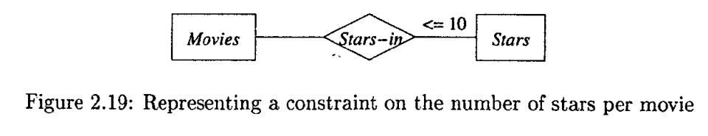
The Modeling of Constraints
Other Kinds of Constraints
Domain constraints restrict the value of an attribute to be in a limited set.
There is no specific notation for domain constraints in the E/R model, but you may place a notation stating a desired constraint next to the attribute, if you wish
Figure 2.19 shows how we can represent the constraint that no movie has more than 10 stars in the E/R model.

Slide 9
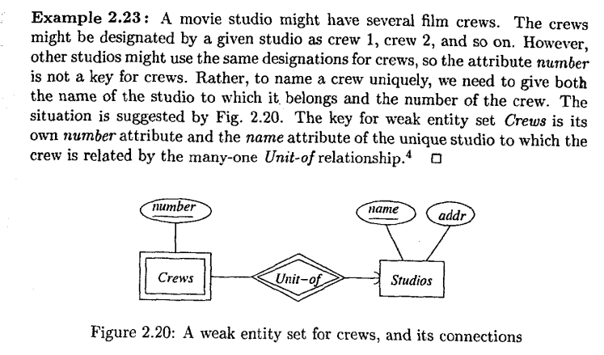
The Modeling of Constraints
Weak Entity Sets
An entity set's key is composed of attributes some or all, of which belong to another entity set. Such an entity set is called a weak entity set

Slide 10
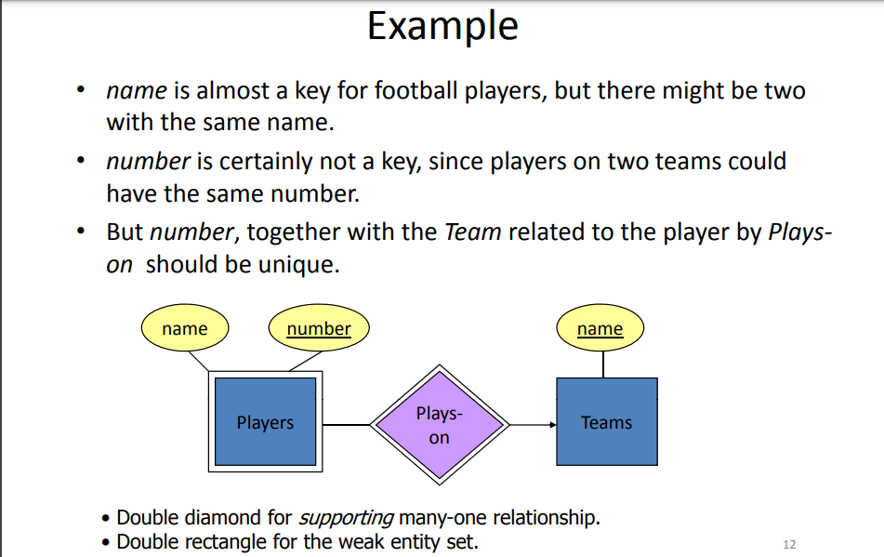
The Modeling of Constraints
Weak Entity Sets

